Slide 1
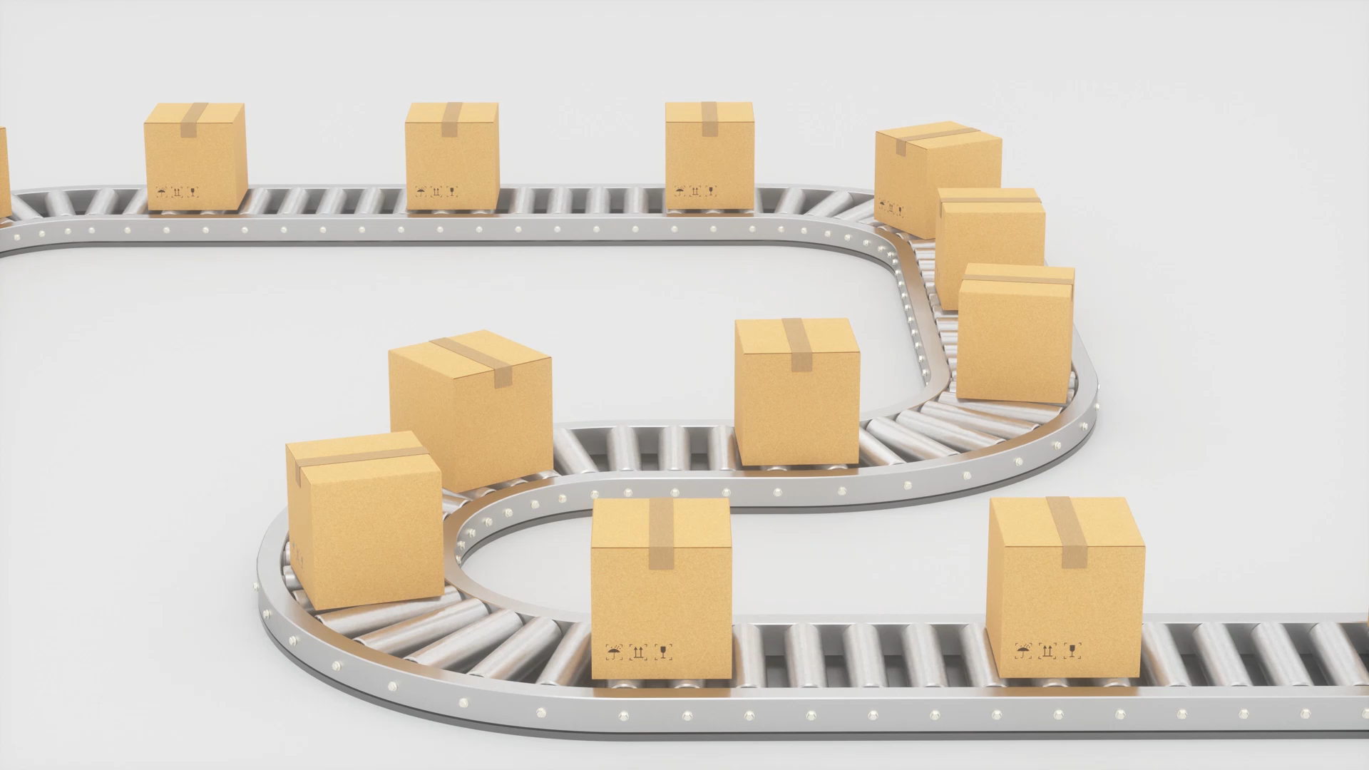
Continuous Delivery
Balakrishna Avula

Slide 2

What & Why
Continuous Delivery enables agile application delivery using Continuous Integration (CI) and Continuous Deployment (CD) to
Improve time to market (e.g. Our flag ship UdaPeople product bug fixes can be delivered in hours instead of days for our customers)
Reduce costs of our product development (e.g. a feature can be added in 10s of man hours instead of 10s of may days)
Improve product quality to increase sales (e.g. automated quality checks and automated testing improve our product thereby improving our reputation and sales)

Slide 3
Current

Slide 4
Future

Slide 5
Costs and Summary

